Slide 1

Knob and Switch Computer
Bevilacqua Joey
Brunner Nicola

Slide 2
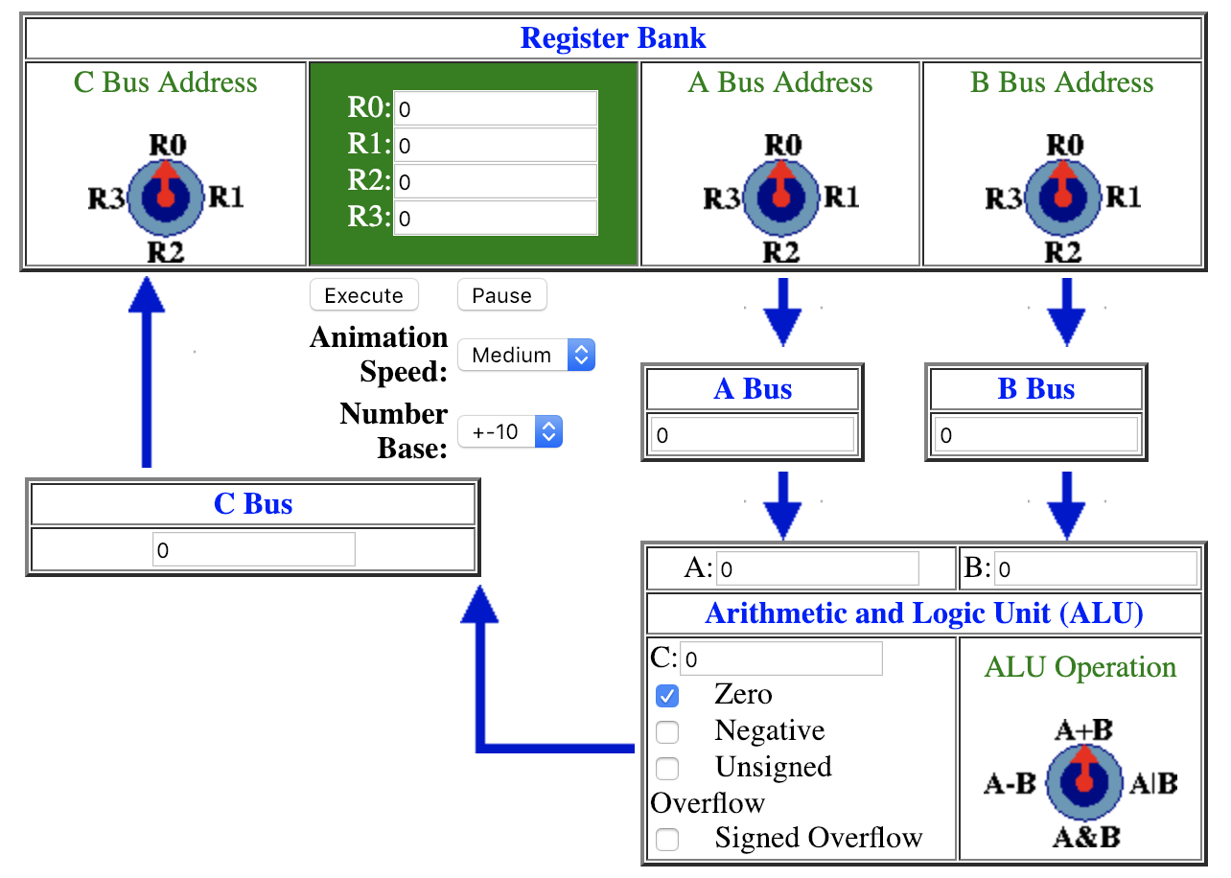
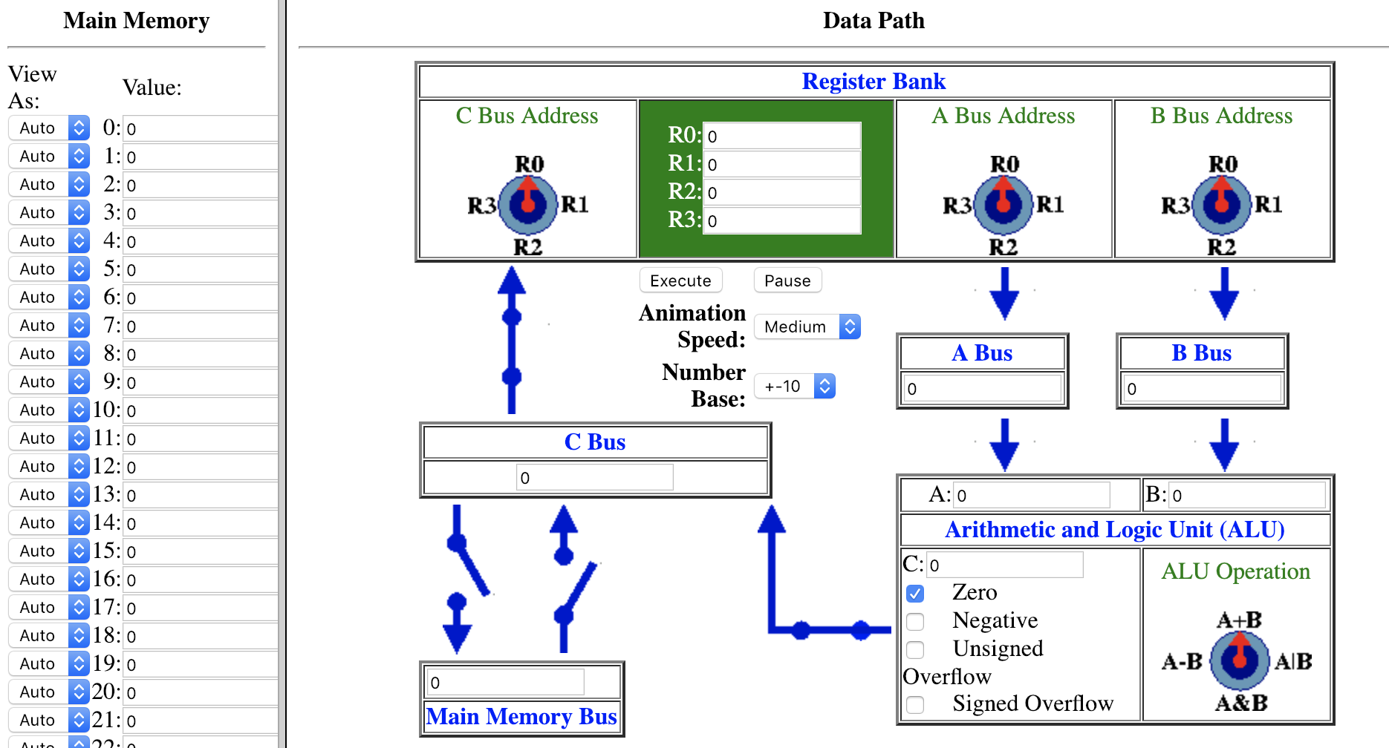

Slide 4


Slide 5
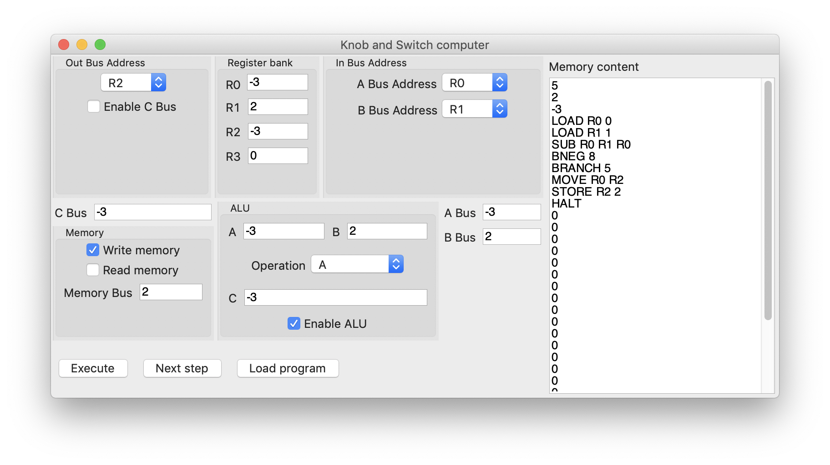

Slide 6



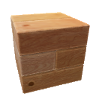


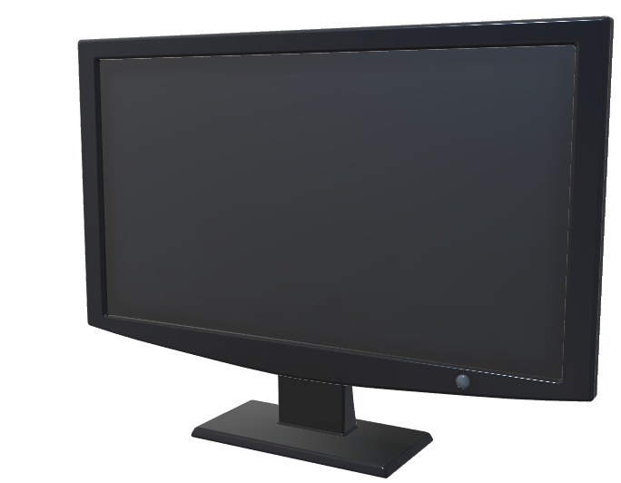
Program architecture

Slide 7
Executor
Program architecture
View
Controller

Slide 8
Executor
1. Initialization

Slide 9
Executor
2. GUI initialization
View

Slide 10

3. View uses logic from the controller
View
Controller

Slide 11
Project management
Staging
Master
Testing
Travis CI

Slide 13
THANK YOU FOR YOUR ATTENTION
(OR NOT…)

